Slide 1
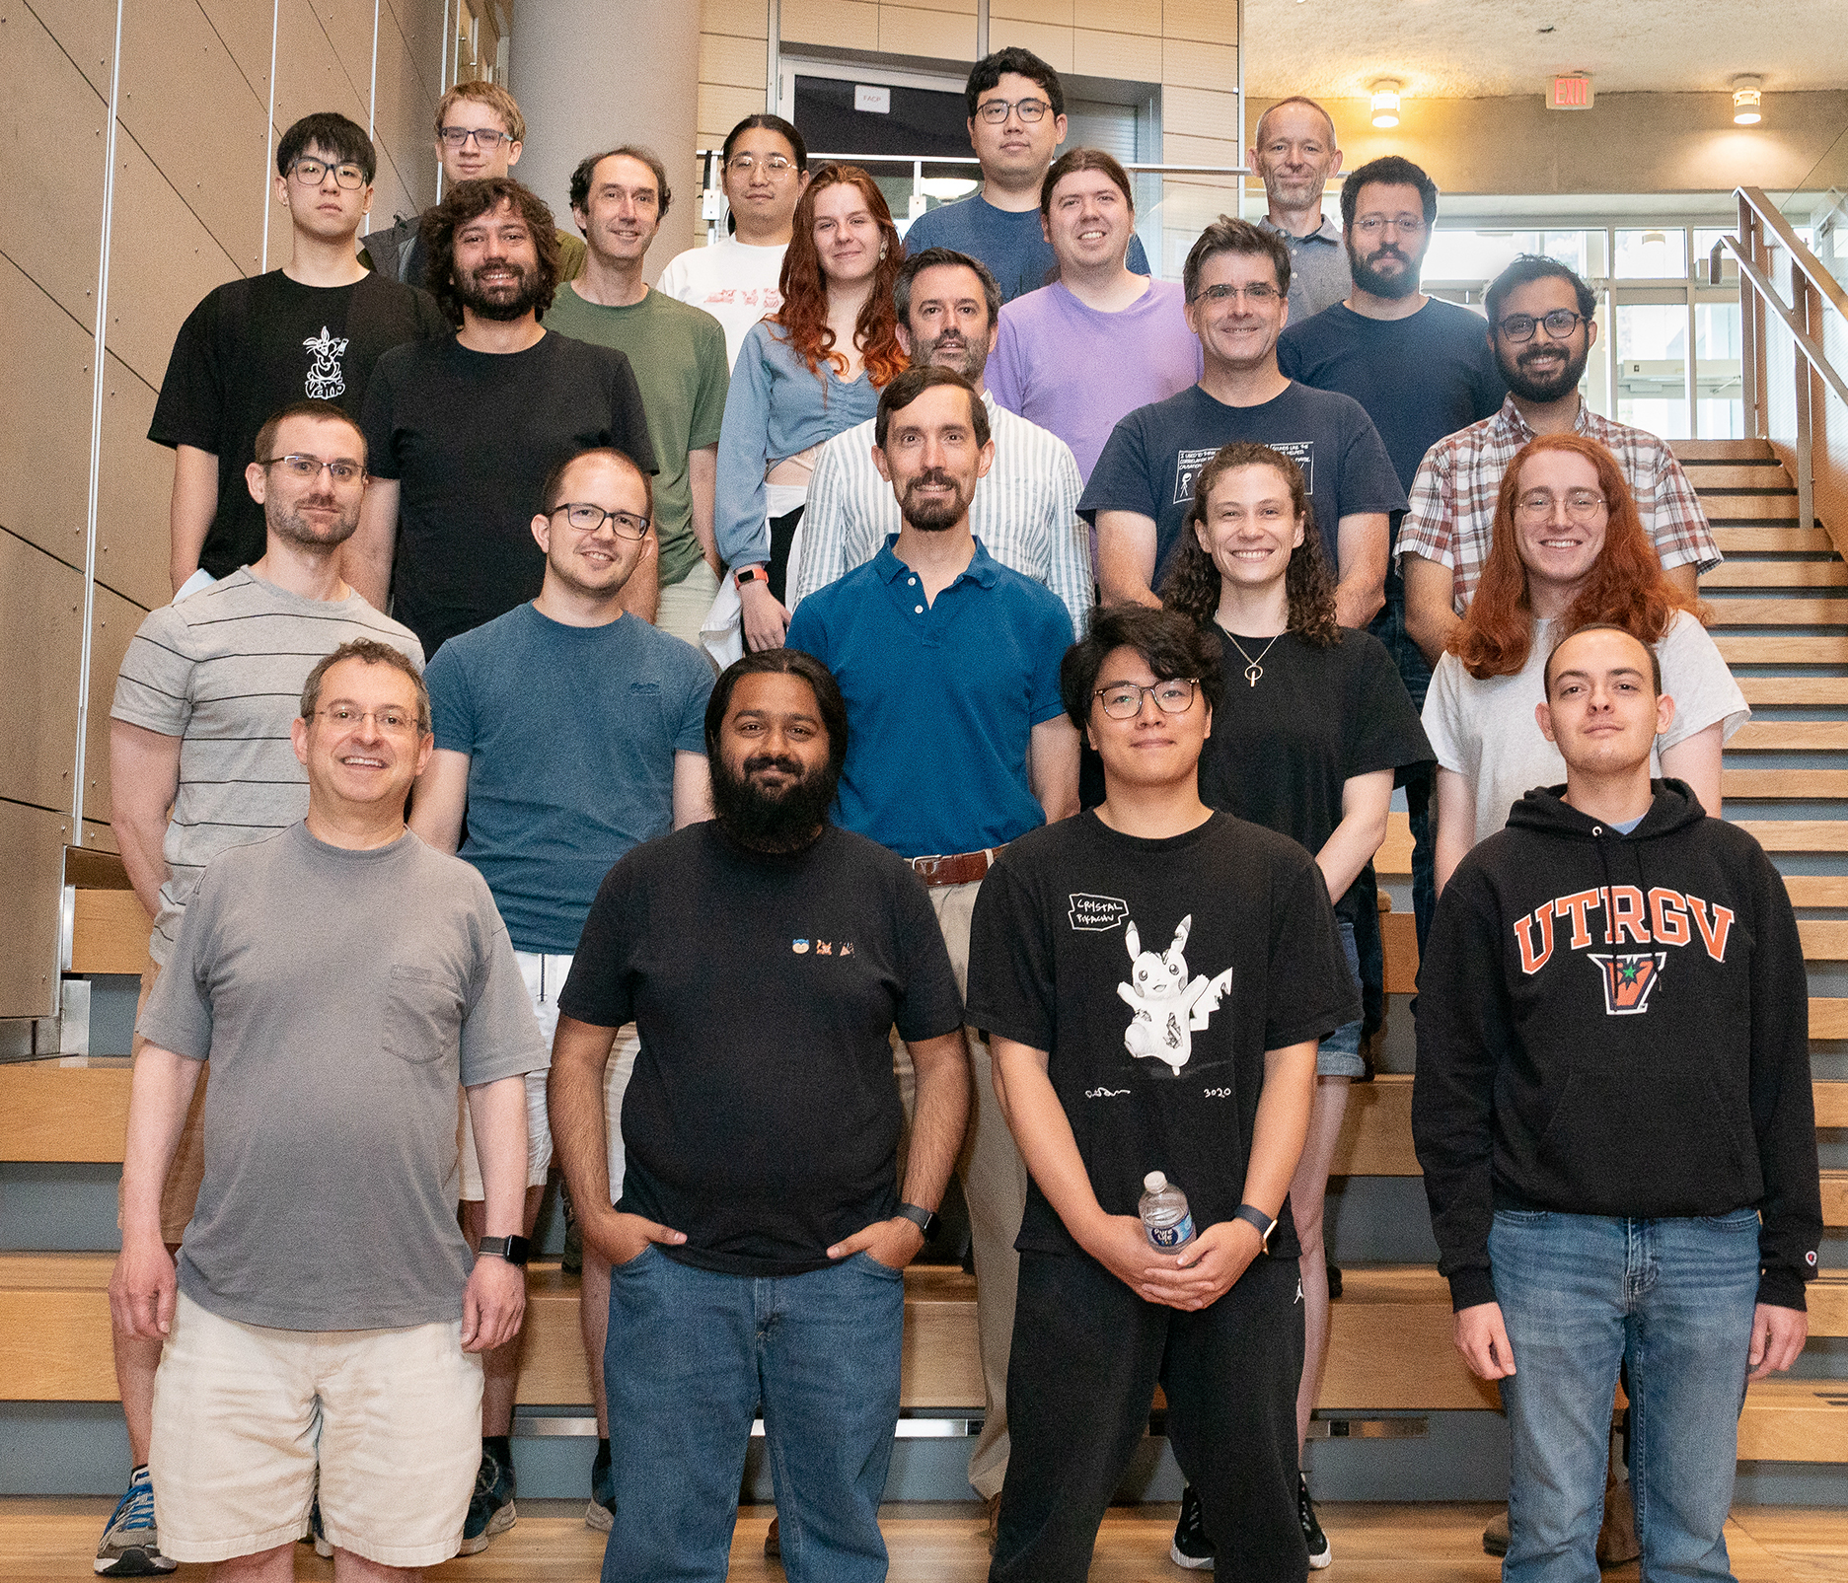

Introduction to Verification
Bryan Parno (and the Verus Team)
Carnegie Mellon University
https://verus.rs/

Slide 2

Imagine a world…
where code worked the 1st time you ran it
where code was proven to be
correct
secure
reliable
at compile time!

Slide 3
Verification can make it happen!
✓
1st Version: Secure,
but non-functional
App
✓
✓
✓
✓
✓
Std. Lib
App Common
✓
✓
✓
UDP/IP
Datatypes
RSA
Ethernet
✓
✓
SHA-256
BigNum
Net Driver
TPM Driver
Core Math
✓
✓
✓
✓
✓
Late
launch
Segments
IOMMU
Device IO
GC

Slide 4
Verification produces better systems
[Yang et al. 2011]
[Fonseca et al. 2017]
[Fisher et al. 2017]
CompCert is the only compiler we have tested for which Csmith cannot find wrong-code errors. This is not for lack of trying: we have devoted about six CPU-years to the task.
[N]one of these bugs were found in the distributed protocols of verified systems, despite that we specifically searched for protocol bugs and spent more than eight months in this process.
A penetration testing expert at DARPA commented that the SMACCMCopter is probably ‘the most secure UAV on the planet.’

Slide 5


Verification can produce faster systems
EverCrypt Crypto Provider
matches or exceeds the performance of state-of-the art (verified or unverified) implementations!

Slide 6
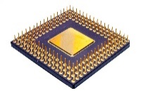
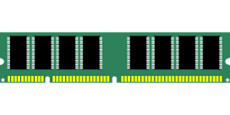

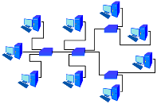

Verification limitations
Proofs are subject to assumptions, not absolute!
Spec

Slide 7
What is Verification?

Slide 8
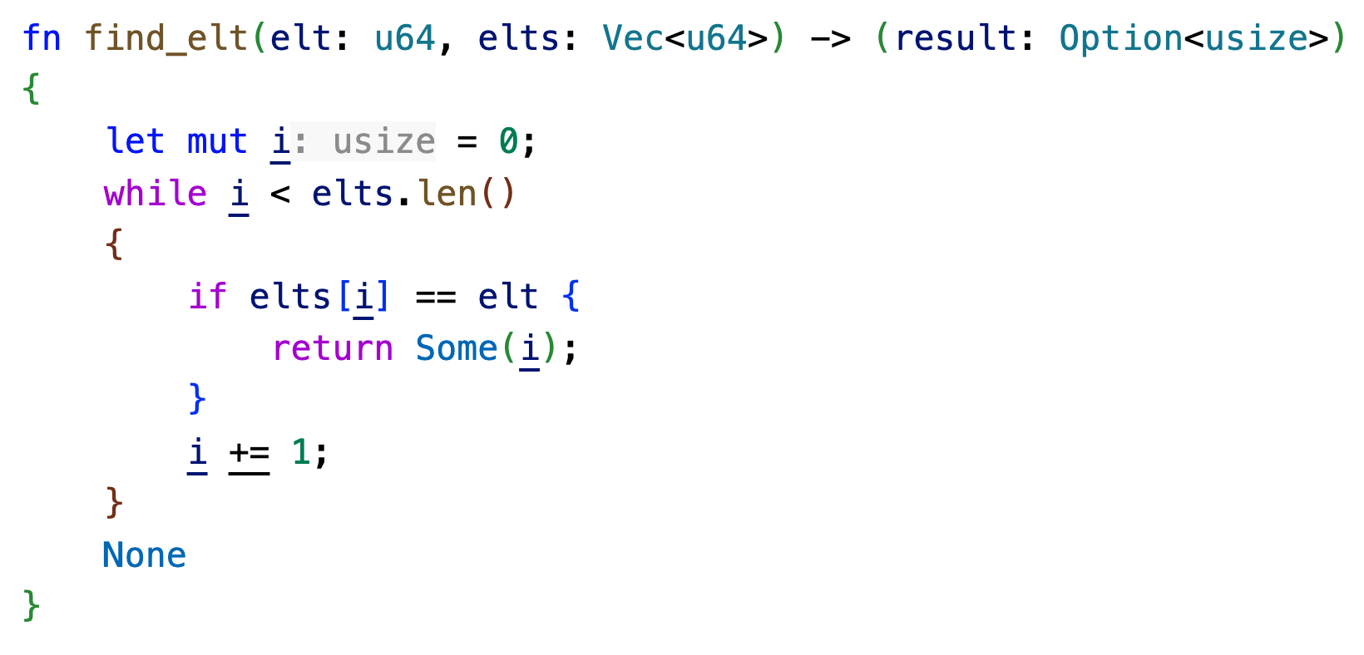
Is this program correct?
Participation Question
Yes
No
Unsure

Slide 9
How would you argue this program is correct?
Program
S
S’
Pre(S)
Post(S’)

Slide 10
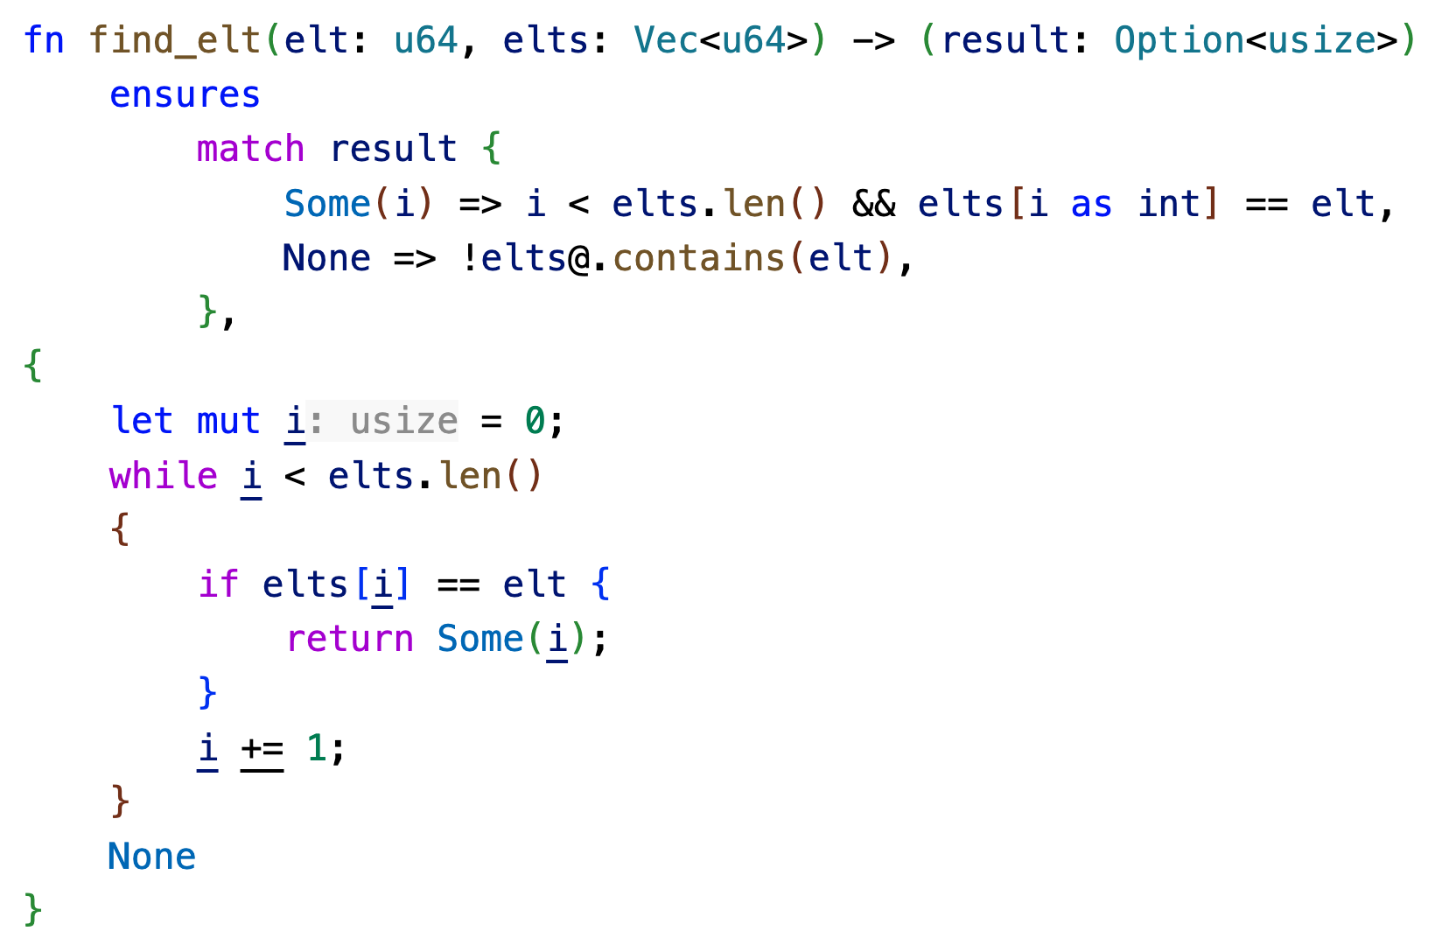
How would you argue this program is correct?
Program
S
S’
Pre(S)
Post(S’)

Slide 11
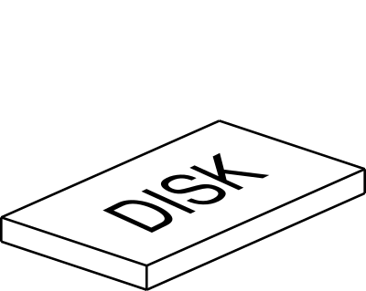
Specifying more complex properties
Host
Host
Network
Host
Host
Host
Network delivering packets
Packet reordering
Packet duplication
Disk
IO queue
Command reordering
Host failure
Host reinitialization
(Limited) spontaneous data corruption

Slide 12
Verification in Practice

Slide 13
Lots of academic examples
Compilers (CompCert, CakeML, …)
Microkernels (seL4, Verve, Atmosphere, …)
Secure applications (Ironclad, Knox, …)
File systems (FSCQ, Yggdrasil, …)
Distributed systems (Ironfleet, Verdi, Ivy,…)
Cryptographic libraries (Evercrypt, SAW, …)
Database optimizations (Cosette, …)

Slide 14
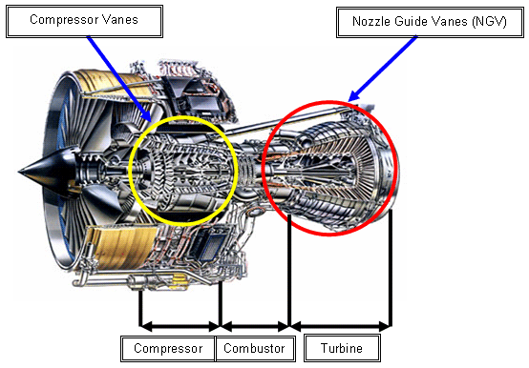

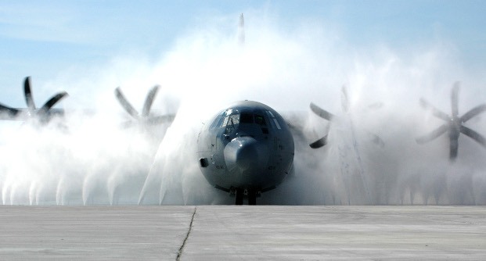


Applications, safety
Commercial
aviation, commercial
traffic management
medical
space
Rolls-Royce Trent jet engines
Lockheed Martin C130J
ACAMS system

Slide 15
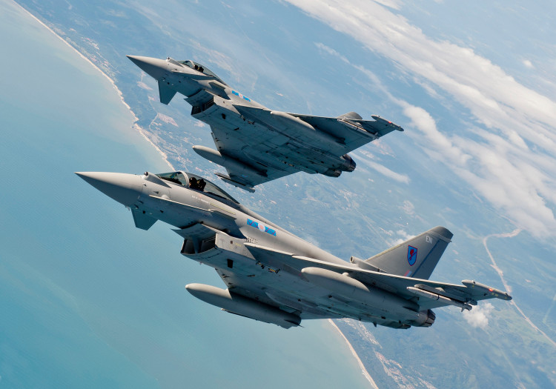








Applications, safety
Commercial
aviation, military
traffic management
medical
space
EuroFighter Typhoon
(Eurofighter Jagdflugzeug GmbH) (Airbus, BAE Systems, Alenia Aermacchi)
AerMacchi M346
Harrier GR9
(Alenia Aermacchi)
(BAE Systems)

Slide 16

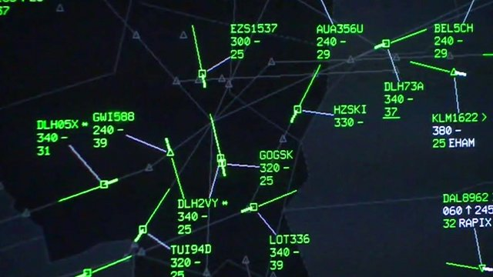
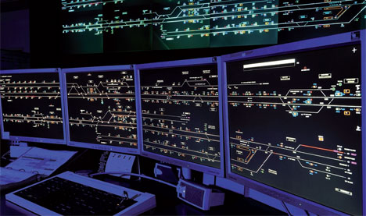
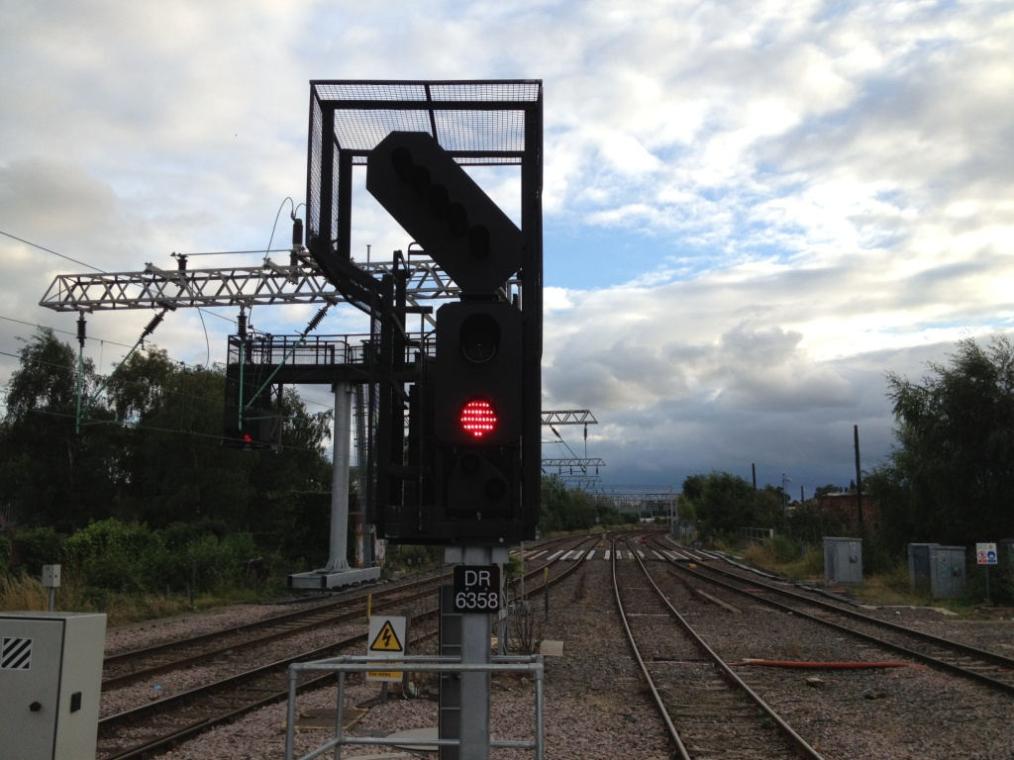
Applications, safety
Commercial
aviation
traffic management
medical
space
NATS iFACTS system (UK)
railway signalling

Slide 17
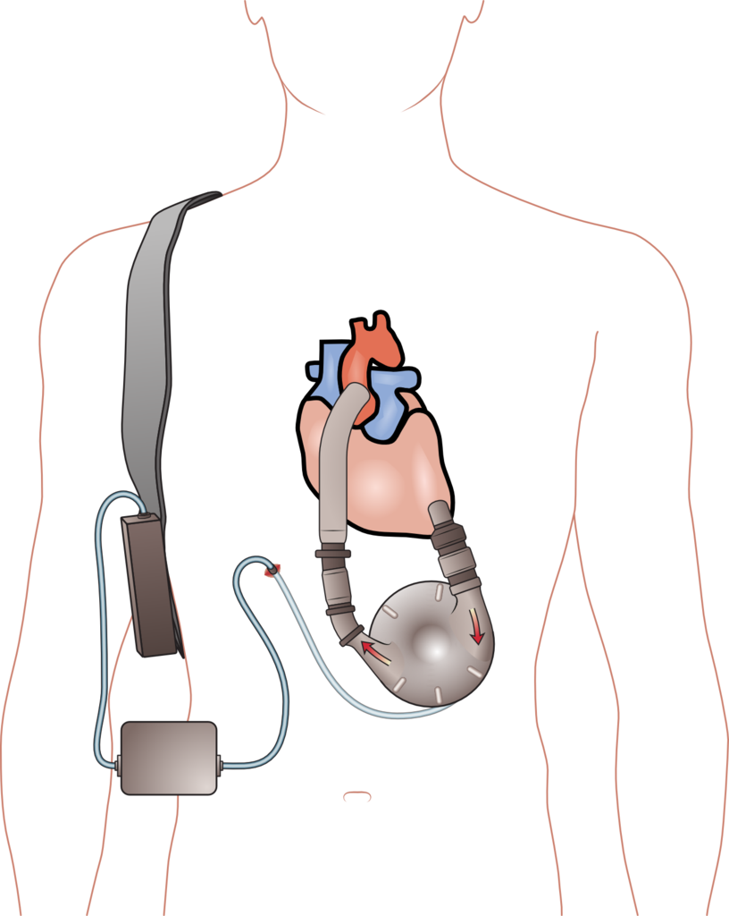
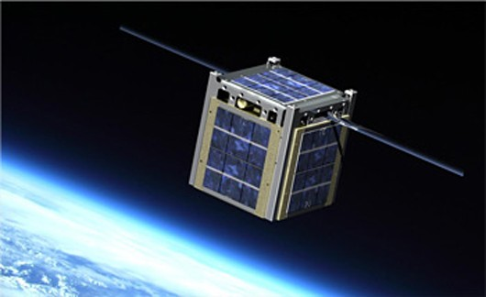
Applications, safety
Commercial
aviation
traffic management
medical
space
LifeFlow ventricular assist device
(University of Virginia)
CubeSat
(Vermont Technical College)

Slide 18
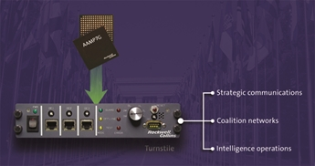
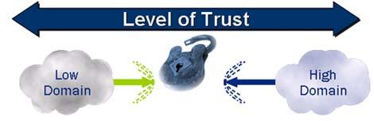
Applications, security
Commercial
cross-domain guard
smart card OS
multi-level workstation
online services
Turnstile, and SecureOne, by Rockwell Collins
(for moving information between security domains)

Slide 19

Applications, security
Commercial
cross-domain guard
smart card OS
multi-level workstation
online services
MULTOS, open standard by MULTOS Consortium

Slide 20


Applications, security
Commercial
cross-domain guard
smart card OS
multi-level workstation
online services
by Secunet

Slide 21
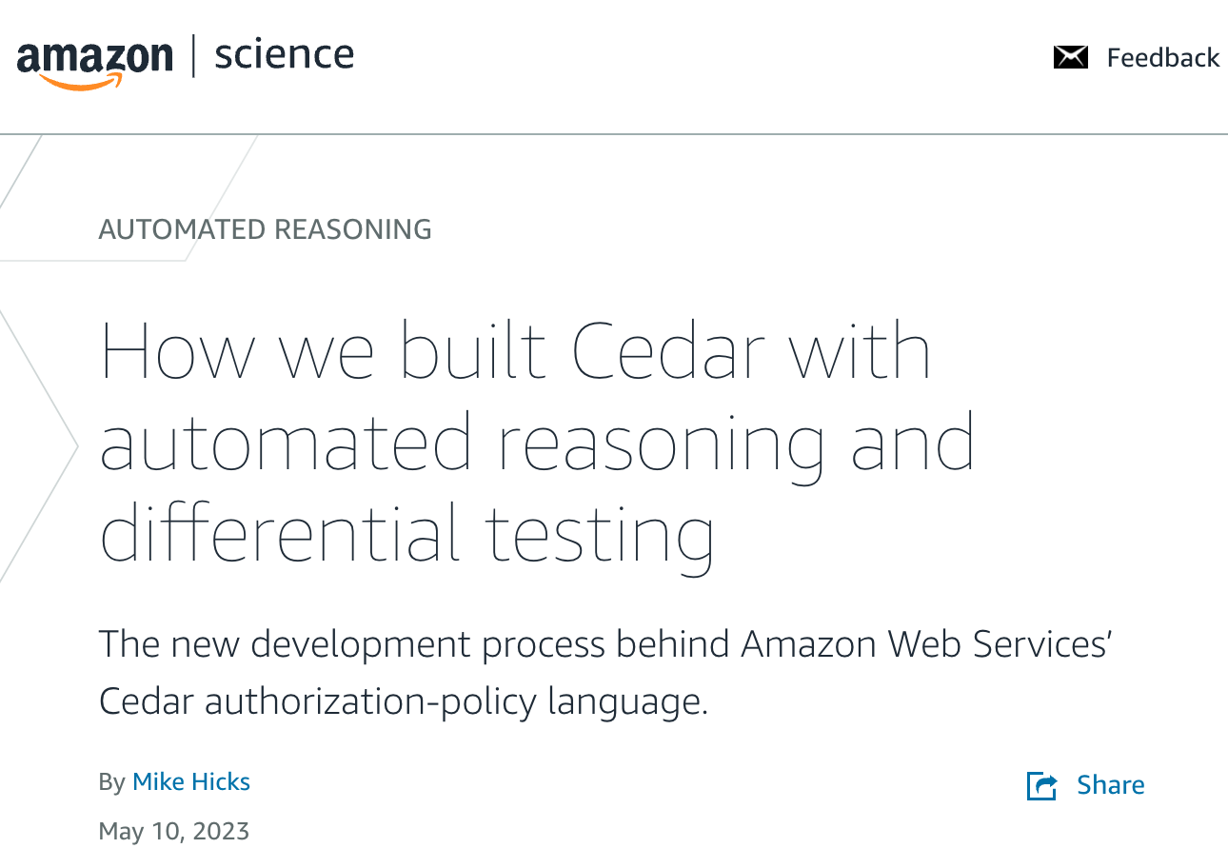

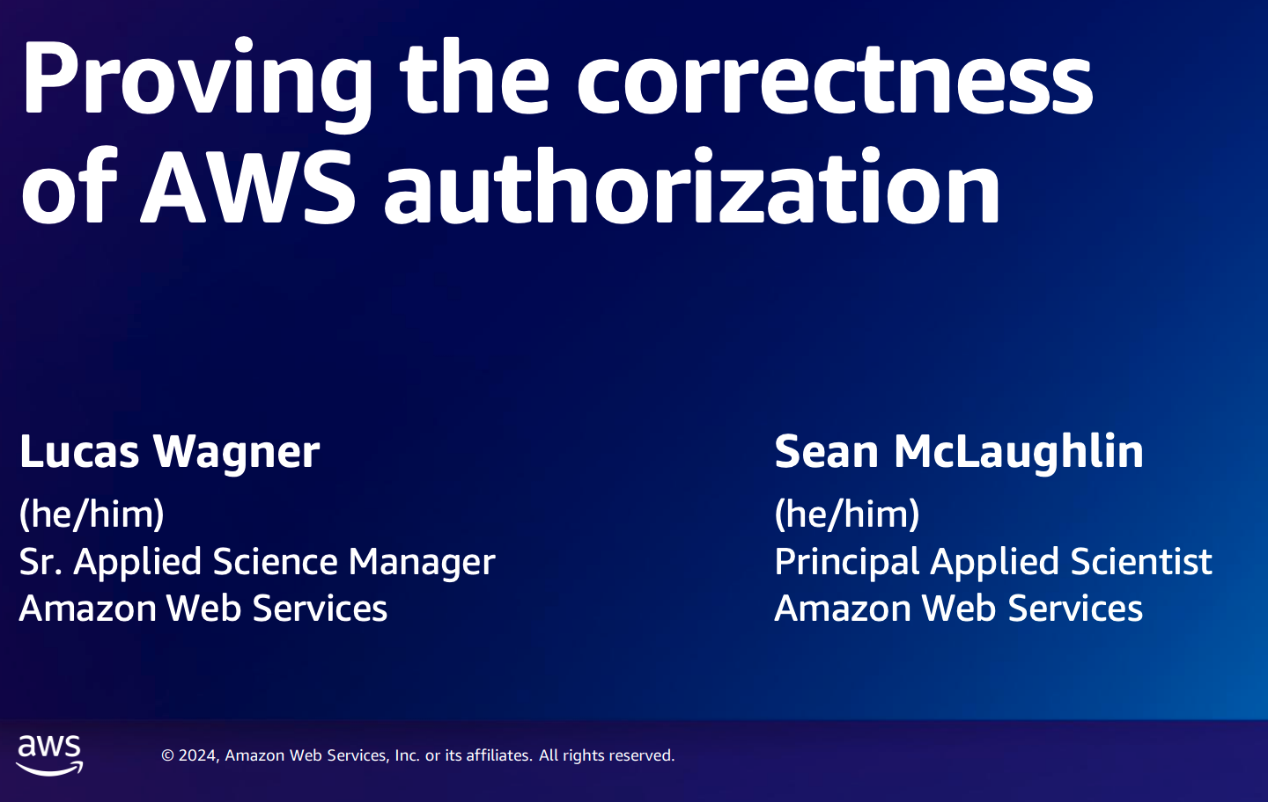

Applications, security
Commercial
cross-domain guard
smart card OS
multi-level workstation
online services

Slide 22
Brief Verus Overview

Slide 23
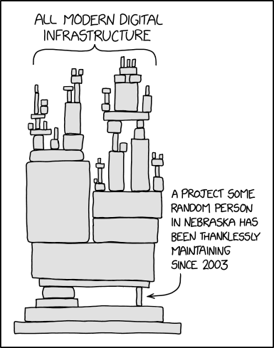
Verus’s Goal
Verify components at the foundation of modern computing
File Systems
Databases
Operating Systems
Distributed Systems
Memory allocators
…

Slide 24

Writing Systems Code is Hard!
Few abstractions
Memory layout matters
No garbage collection
Performance critical
Concurrency!

Slide 25

Rust Ensures Fast, Safe Systems Code
Rust is like C/C++:
Low-level pointer manipulation
No garbage collector
Structs inside structs
In-place mutation of fields
Rust is like Haskell/ML:
Type-safe & thread-safe
Algebraic datatypes
Pattern matching
Side effects are restricted
Rust is unique:
Linear types
Borrowing

Slide 26
Verus: Verifying Rust Code
Mathematically prove code is correct/reliable/secure
Focus on fast, deterministic proof automation for systems code
Ergonomic reasoning about (highly complex) concurrent code
Result: Scaling verification to large, complex systems

Slide 27
How Does Verus Work?
Validate proofs
Verus source
Rust
+
Specification
+
Proof
rustc typechecking
& borrow-checking
Verus
Solvers (e.g., Z3)
Rust
Executable
Binary

Slide 28
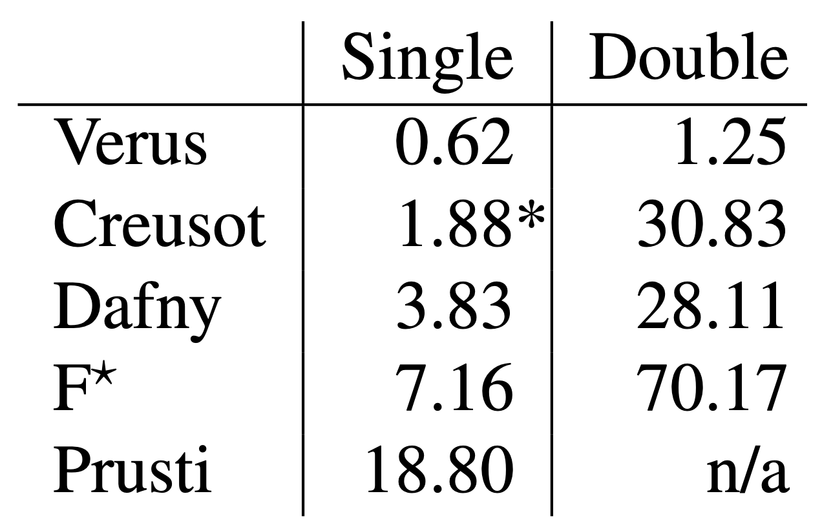
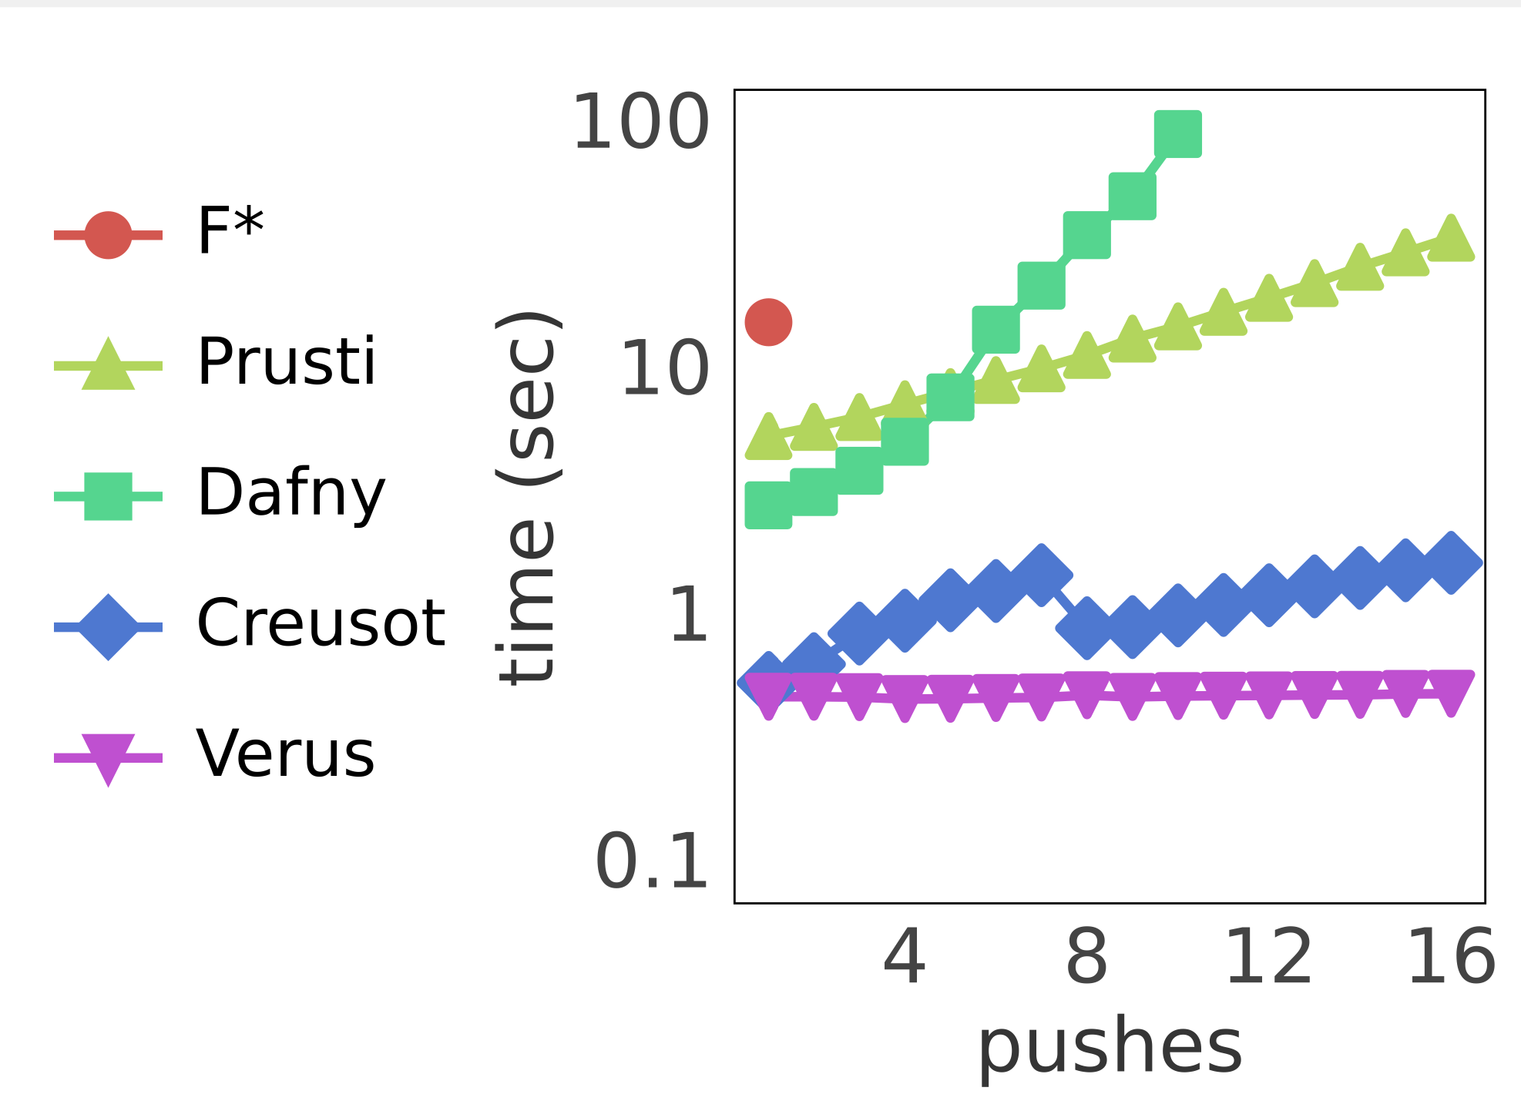
Verification Perf: Milli Benchmarks
3-30x slower
22-56x slower
Notes:
singly linked list implementations, we evalu- ate the cost of memory reasoning by repeatedly updating four instances of the singly linked list within the same function.

Slide 29
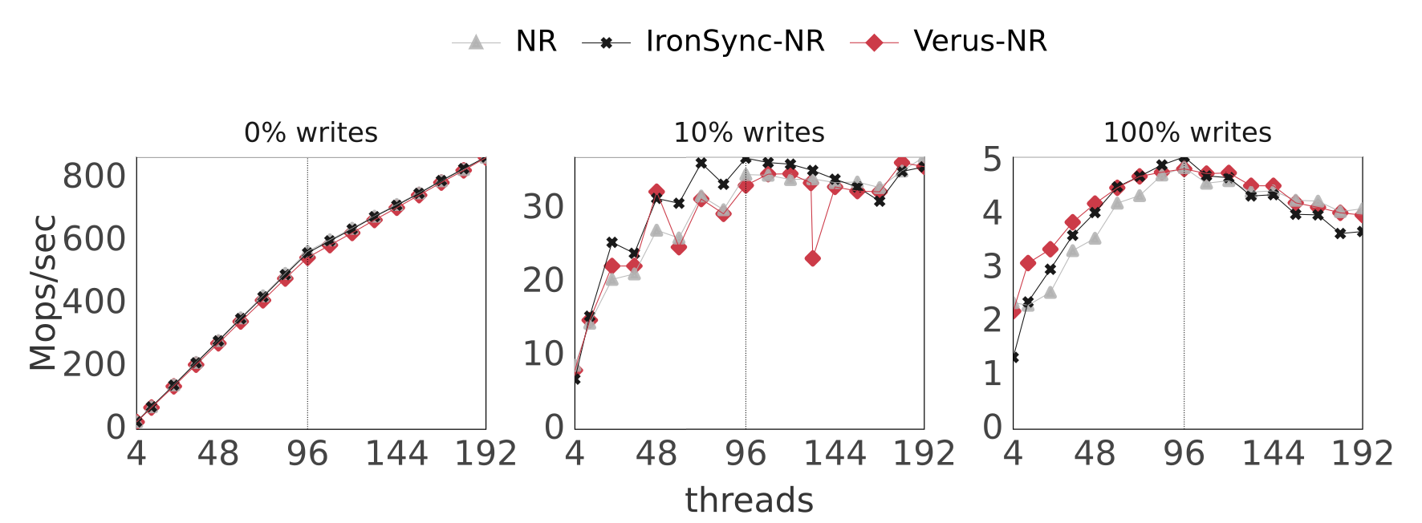
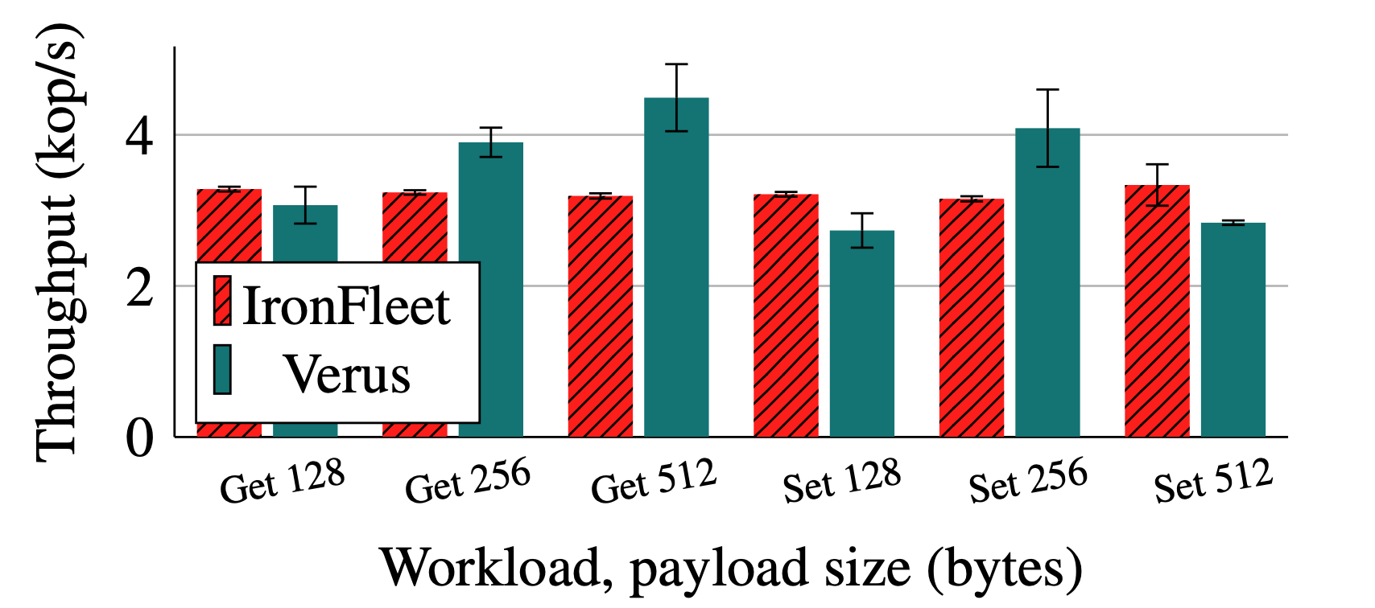
Verification Perf: Macro Benchmarks
System | P/C ratio | Verif. Time (s)
Key-Value store - Verus | 2.9 | 49
Key-Value Store - Dafny | 4.2 | 441
NUMA Replica - Verus | 7.2 | 21
NUMA Replica - Dafny | 10.7 | 1130
~1600 LoC
~700 LoC

Slide 30
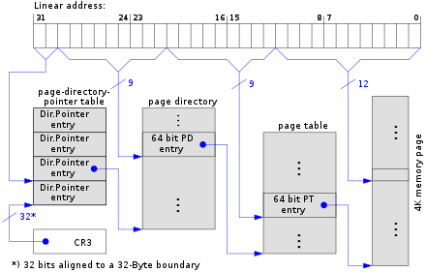
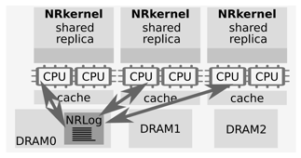
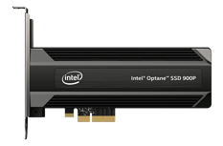



Verus Verified Systems
Distributed
Key-Value Store
OS Page Table
NUMA-aware Replica Library
Concurrent
Memory Allocator
Persistent-
Memory Log
Kubernetes
Controllers
Security Module for Confidential VMs

Slide 31
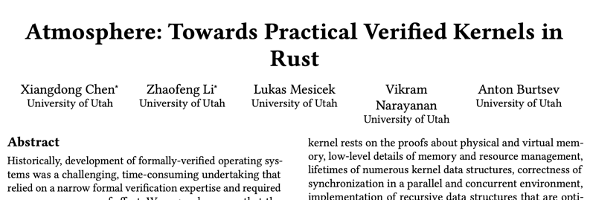
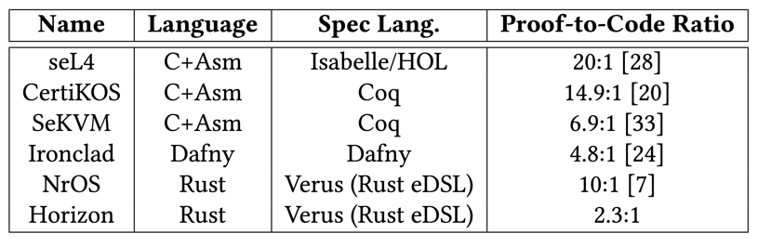
Proofs are becoming cheaper!
Atmosphere

Slide 32
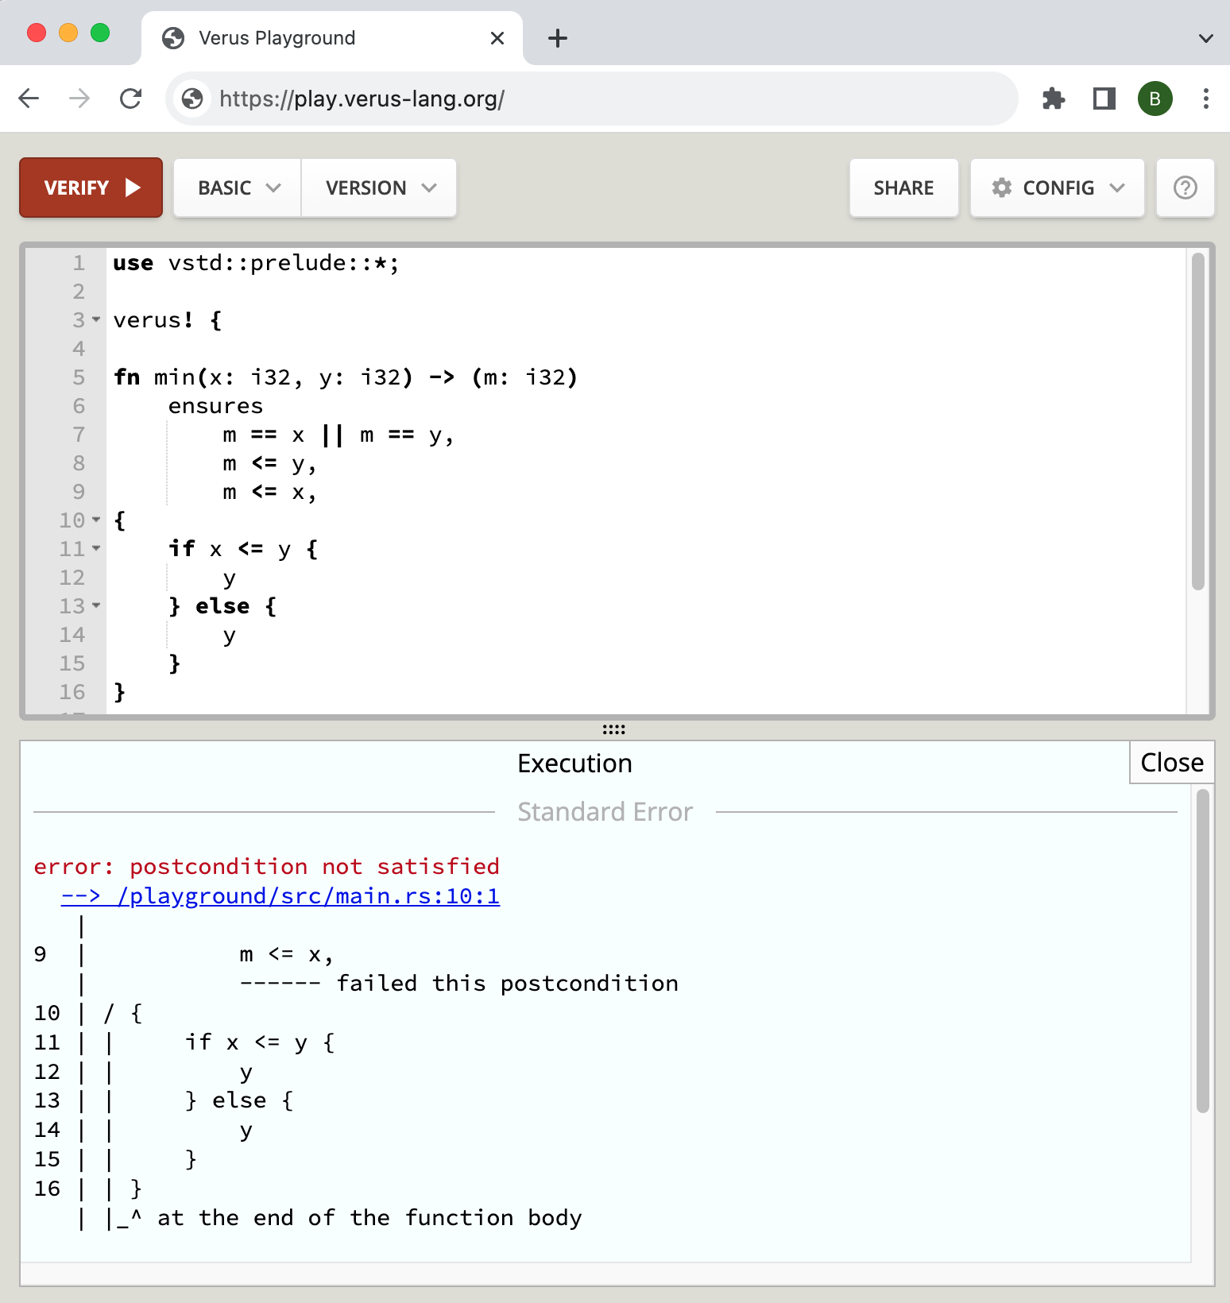
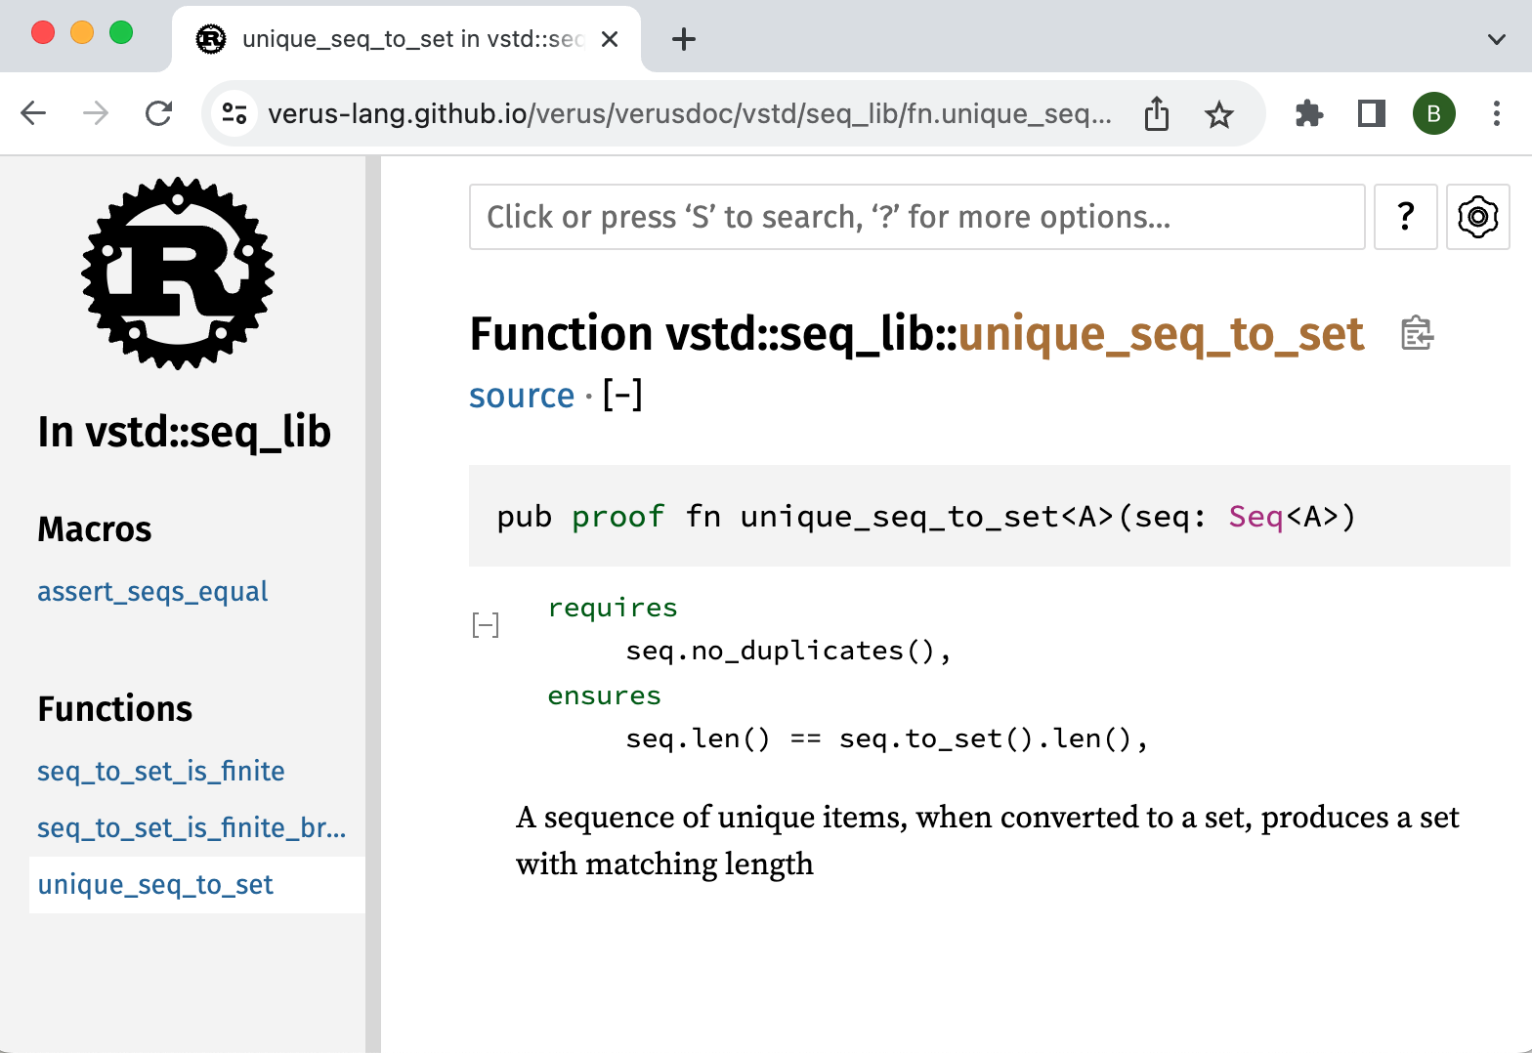
Trying Verus

